Slide 1



Problem no-122 Group no-B_22
Develop an indoor farming system for growing the fresh produce in urban environment
Problem statement
Name | University Roll no | Library ID
Mohd Yavar | 202401100600114 | 2428it1415
Pushkar Garg | 202401100600132 | 2428it1021
Harshit Gupta | 202401100600088 | 2428it1341

Slide 2
URBAN ROOTS
THE SOLUTION

Slide 3
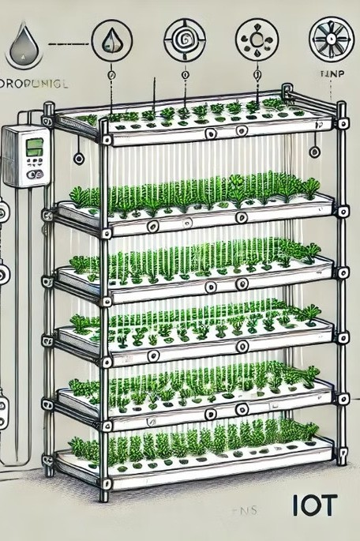
Bridging the Urban Food Gap: Indoor Vertical Farming
Empathize :
Urban Residents: Limited access to fresh produce in crowded cities.
Farmers and Hobbyists: Need for efficient, low-maintenance farming methods.
Educators and Students: Opportunities for learning sustainable farming techniques.
Imagine a future where fresh, healthy produce is accessible to everyone, regardless of location.

Slide 4

The Problem: Urban Food Insecurity
Define :
Limited Access
Urban residents often lack access to affordable, fresh produce.
Transportation Barriers
Transportation costs and limited options can make fresh food out of reach.
Availability of organic Produce
In urban cities the availability of pesticide free food is difficult

Slide 5
A Solution: Indoor Vertical Farming
Ideate :
Structure
Multi-tiered systems maximize space and yield.
Lighting
Controlled LED lighting optimizes plant growth.
Hydroponic System
Water-based nutrient delivery for efficient growth.
Environmental Control
Climate-controlled environment for ideal growing conditions.

Slide 6
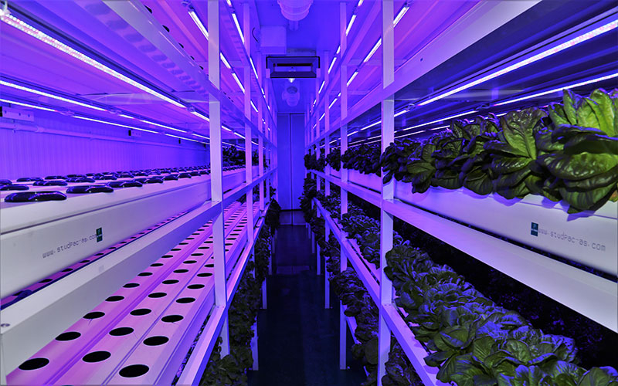

Benefits of Vertical Farming
1
Increased Yield
Higher density planting allows for greater productivity.
2
Reduced Water Usage
Hydroponic systems are highly efficient in water use.
3
Minimized Waste
Controlled environment reduces spoilage and food waste.
4
Year-Round Production
Climate-controlled environment enables continuous growth.

Slide 7
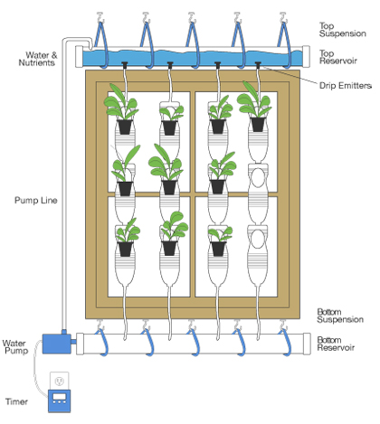
Sustainability and Environmental Impact
Water Conservation
Hydroponics minimizes water usage compared to traditional farming.
Reduced Pesticide Use
Controlled environment eliminates the need for harmful pesticides.
Renewable Energy
Vertical farms can utilize solar power for sustainable energy.

Slide 8





SDG goals
SDG : Zero Hunger
Enables fresh food production in urban areas, addressing food insecurity.
Promotes self-sufficiency by empowering individuals to grow their own food.
SDG 6: Clean Water and Sanitation
Hydroponic systems recycle water, using 90% less water than traditional farming.
Provides a sustainable solution for regions facing water scarcity.
SDG 11: Sustainable Cities and Communities
Modular design allows farming in compact urban spaces, e.g., apartments, schools.
Reduces the environmental footprint of food production and transportation.

Slide 9
Challenges in Implementing Vertical Farming
Capital Investment
Initial setup costs can be significant.
1
Technological Expertise
Requires skilled personnel for operation and maintenance.
2
Space Constraints
Finding suitable urban locations can be challenging.
3

Slide 10
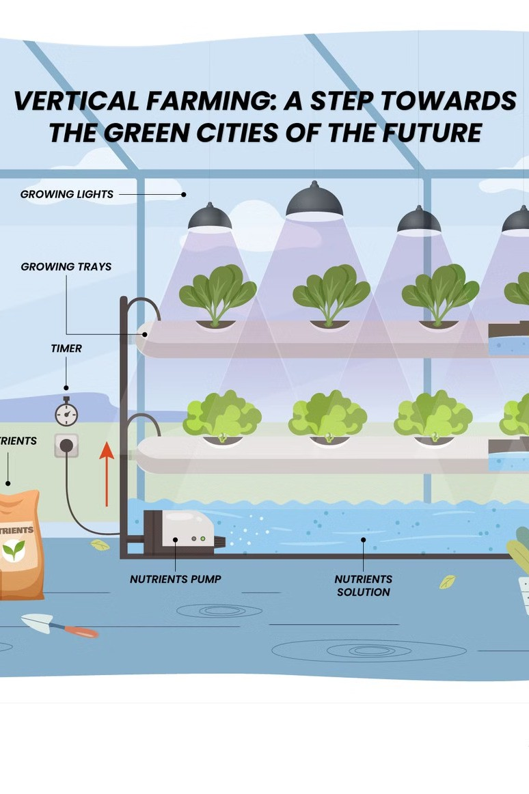
Future Prospects of Vertical Farming
1
Increased Efficiency
Continued advancements in technology will improve yield and resource use.
2
Urban Integration
Vertical farms will become increasingly integrated into cities.
3
Consumer Demand
Growing consumer interest in local and sustainable food will drive demand.

Slide 11
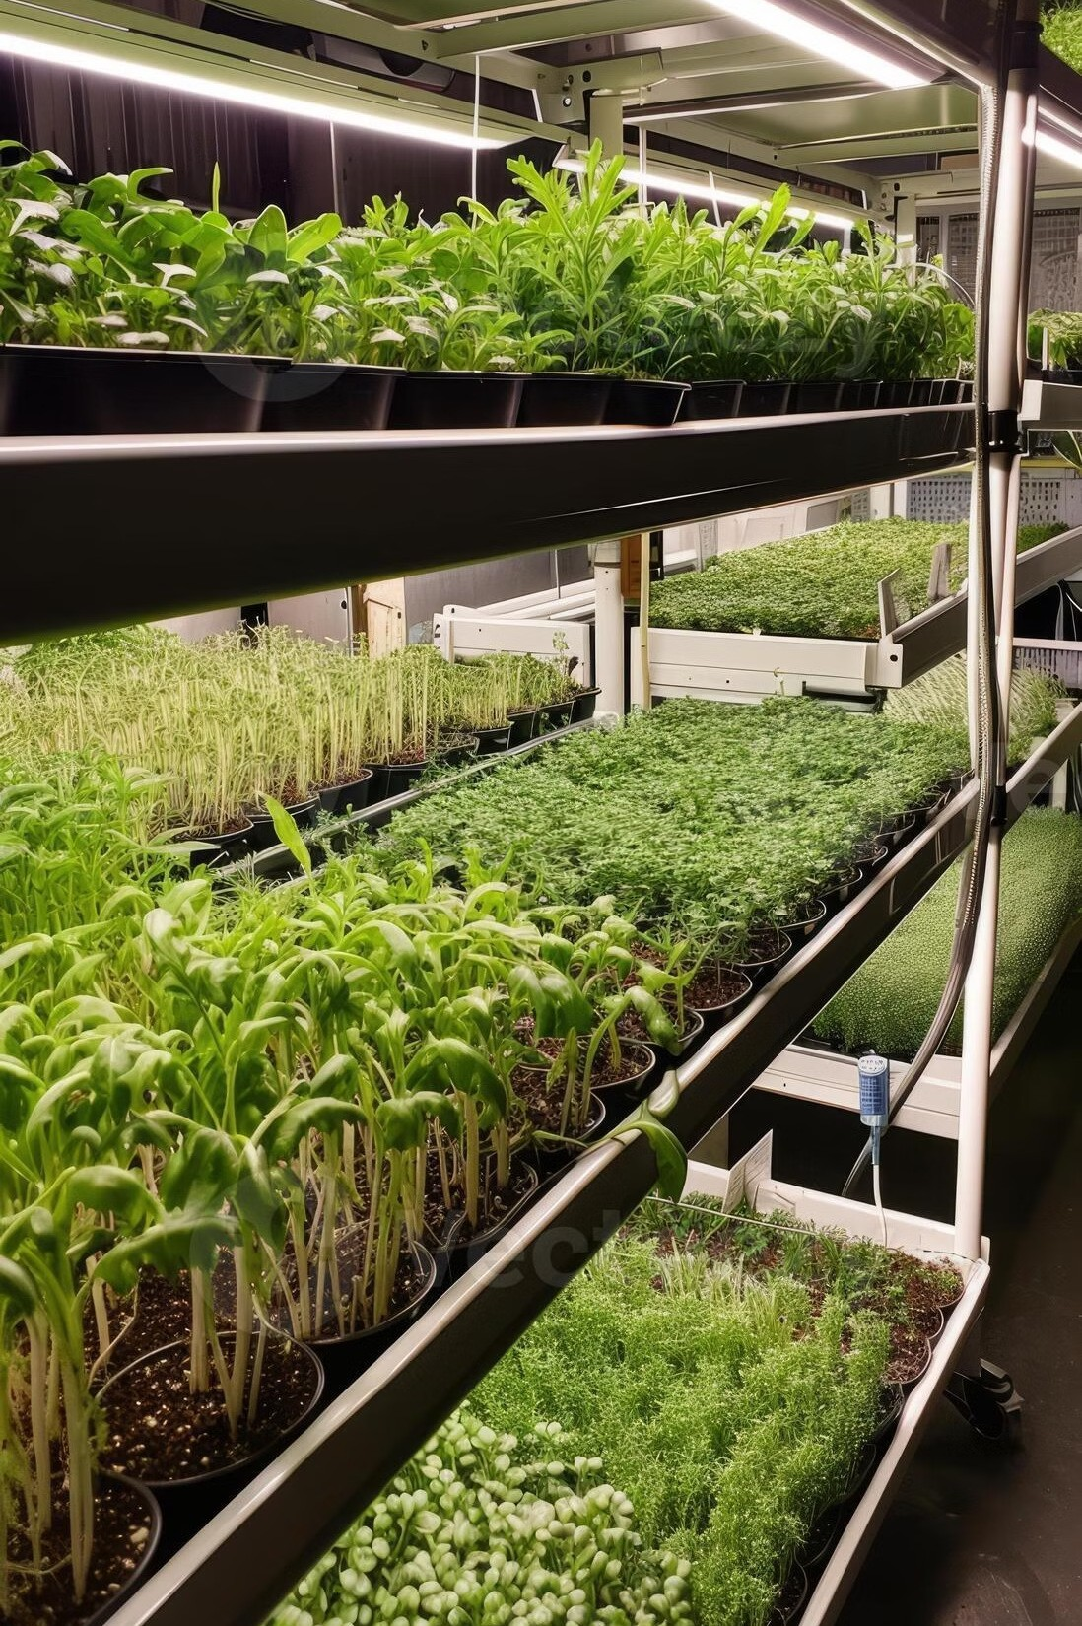
Conclusion and Next Steps
Vertical farming has the potential to revolutionize urban food production, providing fresh, healthy food while mitigating environmental impacts. We must address the challenges and invest in research and development to unlock the full potential of this innovative technology.

Slide 12

THANK YOU

